Slide 1
FACTORS
AND
FACTORIALS
L - 1

Slide 2
Factors
  Concepts of Factors and Multiples
  Number of factors
  Sum of factors
  Product of factors
  Number of odd and even factors
Factorials
  Concept of Number of Zeros
  Highest power of a number in a factorial
  Number of zeroes in a factorial
  Miscellaneous Problems

Slide 3
Factors: All the numbers that divide a number completely, i.e., without leaving any remainder, are called factors of that number.
Multiples: A given number which can be divided by another number without leaving any remainder, is called a multiple of another number.
For example, 24 is completely divisible by 1, 2, 3, 4, 6, 8, 12, 24. Each of these numbers is called a factor of 24 and 24 is called a multiple of each of these numbers.
FACTORS

Slide 4
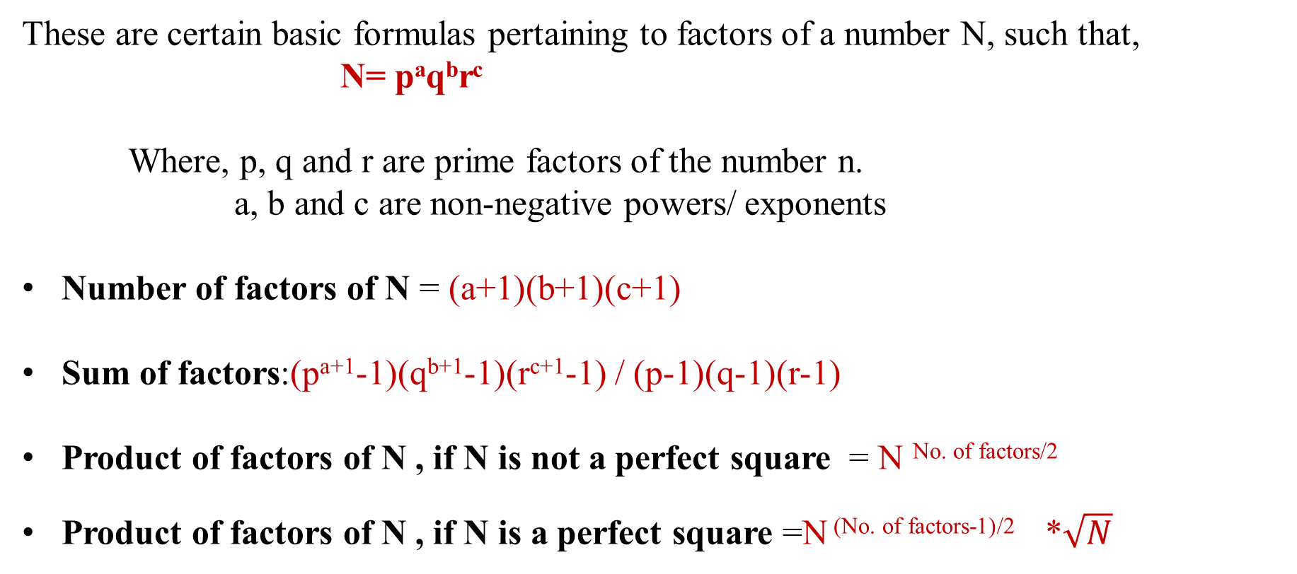
FACTORS

Slide 5
FACTORS
Number of even Factors and odd factors:
Let N is a number.
N (Prime factorization) = a^p × b^q × c^r
No. of factors of N = (p+1)(q+1)(r+1)
Now suppose that b and c are odd prime numbers in prime factorization of N
Now to find even no of factors you have to find odd no of factors first.
Odd no of factors = (q+1)(r+1)
Even no of factors = (total no of factors) - (odd no of factors).

Slide 6
FACTORS
1. What is the number of factors of 1125?
A. 8 B. 12 C. 22 D. 24
Notes:
Difficulty Level: Easy
Option B
Compulsory

Slide 7
FACTORS
Notes:
Difficulty Level: Easy
Option D
Compulsory

Slide 8
FACTORS
Notes:
Difficulty Level: Easy
Option C

Slide 9
FACTORS
4. What is the sum of the factors of 72?
A. 220 B. 145 C. 195 D. 260
Notes:
Difficulty Level: Moderate
Option C
Compulsory

Slide 10
FACTORS
5. What is the sum of the factors of 600?
A.1560 B. 1650 C. 1770 D. 1860
Notes:
Difficulty Level: Moderate
Option D
Compulsory

Slide 11
FACTORS
6. What is the product of the factors of 361?
A. 19^5 B. 19^3 C. 19^10 D. None
Notes:
Difficulty Level: Moderate
Option B
Compulsory

Slide 12
FACTORS
7. What is the product of the factors of 1024?
A. 2^58 B. 2^36 C. 2^55 D. None
Notes:
Difficulty Level: Moderate
Option C
Compulsory

Slide 13
FACTORS
8. What is the product of the factors of 360?
A. 360^12 B. 360^8 C. 360^16 D. None
Notes:
Difficulty Level: Moderate
Option A

Slide 14
FACTORS
9. What is the product of the factors of 524?
A. 524^2 B. 524^3 C. 524^6 D. None
Notes:
Difficulty Level: Moderate
Option B

Slide 15
FACTORS
10. Find the smallest number that has exactly 18 factors?
A. 156 B. 180 C. 360 D. 760
Notes:
Difficulty Level: Difficult
Option B
Compulsory

Slide 16
FACTORS
11. Find the odd factors of 252?
A. 8 B. 5 C. 7 D. 6
Notes:
Difficulty Level: Moderate
Option D
Compulsory

Slide 17
FACTORS
12. How many factors of 2^4 * 5^3 * 7^4 are odd numbers?
A. 20 B. 25 C. 27 D. 29
Notes:
Difficulty Level: Moderate
Option A
Compulsory

Slide 18
FACTORS
13. Number N = 2^6 * 5^5 * 7^6 * 10^7; how many factors of N are even numbers?
A.1183 B. 1173 C. 1673 D. 190
Notes:
Difficulty Level: Moderate
Option A
Compulsory

Slide 19
Number of zeroes:
It is very easy to find the number of zero at the end , all you have to do is count how many times did 2 and 5 occurred in the question as factor. Number of zeros is equal to the one (2 or 5)which occurred less times. i.e. 2*5 = 10
2*2*5*5 = 100
So the number of zeros depends upon the number of pairs of 2 and 5.
Example 1. How many numbers of zeros will be there at the trail (end) of the 1*2*3*4*5*6*7*8*9*10?
Solution:
In given expression number of 2’s = 8
Number of 5’s = 2
So total number of pairs = 2
Two zeroes will be there at the end of the calculation.
FACTORIALS

Slide 20
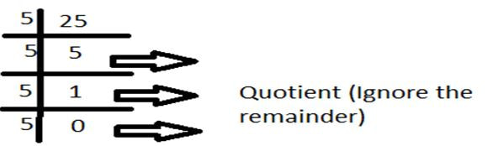
Number of zeroes in a factorial:
FACTORIALS
There will be 5+1+0 = 6 zeroes at the end of 25!

Slide 21
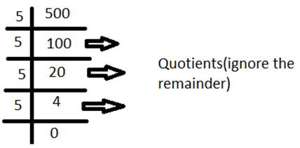
FACTORIALS
Example . Find the number of zeros at the end of 500!
Solution:
Total number of 5’s = 100+20+4 = 124

Slide 22
FACTORIALS
14. The highest power of 3 that completely divides 43! is:
A] 19 B] 26 C] 16 D] 15
Notes:
Difficulty Level : Difficult
Option: A
Compulsory

Slide 23
FACTORIALS
15. What is the highest power of 7 in 100 factorials?
A] 16 B] 12 C] 21 D] 23
Notes:
Difficulty Level : Difficult
Option: A
Compulsory

Slide 24
FACTORIALS
16. What is number of trailing zeroes in 12135000?
A] 0 B] 2 C] 3 D] 5
Notes:
Difficulty Level : Easy
Option: C

Slide 25
FACTORIALS
17. What is number of trailing zeroes in 121350001?
A] 0 B] 2 C] 3 D] 5
Notes:
Difficulty Level : Easy
Option:A

Slide 26
FACTORIALS
18. Find the number of zeros in 182! ?
A] 44 B] 42 C] 51 D] 48
Notes:
Difficulty Level : Difficult
Option: A
Compulsory

Slide 27
FACTORIALS
19. Find the number of zeros in 532! ?
A] 144 B] 142 C] 131 D] 148
Notes:
Difficulty Level : Difficult
Option: C
Compulsory

Slide 28
FACTORIALS
20. What is the number of trailing zeroes in 1173!
A] 214 B] 233 C] 265 D] 290
Notes:
Difficulty Level : Moderate
Option: D
Compulsory

Slide 29
FACTORIALS
21. Find the No. of zeroes at the end of 2^7 × 3^5 × 5^8 × 7^5 × 8^3 × 10^5.
A] 13 B] 17 C] 15 D] 20
Notes:
Difficulty Level : Moderate
Option: A
Compulsory

Slide 30
FACTORIALS
22. Which of the following cannot be the number of zeroes at the end of any factorial?
A] 25 B] 26 C] 30 D] 36
Notes:
Difficulty Level : Moderate
Option: C

Slide 31
FACTORIALS
23. If the number of zeros are 117 for the number x!, then find the least value of x?
A] 289 B] 326 C] 430 D] None
Notes:
Difficulty Level : Expert
Option: D

Slide 32
FACTORIALS
24. How many trailing zeroes (zeroes at the end of the number) does 70!+50! have?
16
28
12
10
Notes:
Difficulty Level : Moderate
Option 3 : 12

Slide 33
FACTORIALS
25. When 40! is expressed in base 8 form, what is the last non–zero digit in the base 8 expansion?
2
6
4
8
Notes:
Difficulty Level : Moderate
Option3 : 4

Slide 34
FACTORIALS
26. Let K be the largest number with exactly 3 factors that divide 25! How many factors does (k – 1) have?
16
12
9
14
Notes:
Difficulty Level : Moderate
Option 1 : 16

Slide 35
FACTORIALS
27. What is the highest power of 12 that divides 54!
25
26
30
4
Notes:
Difficulty Level : Moderate
Option 1 : 25

Slide 36
FACTORIALS
28. How many values can natural number n take, if n! is a multiple of 2^20 but not 3^20?
11
21
16
5
Notes:
Difficulty Level : Expert
Option 2 : 21

Slide 37
FACTORIALS
29. How many values can natural number n take, if n! is a multiple of 7^6 but not 7^9?
7
21
14
12
Notes:
Difficulty Level : Moderate
Option 3 : 14

Slide 38
Any Doubts???

